Slide 1
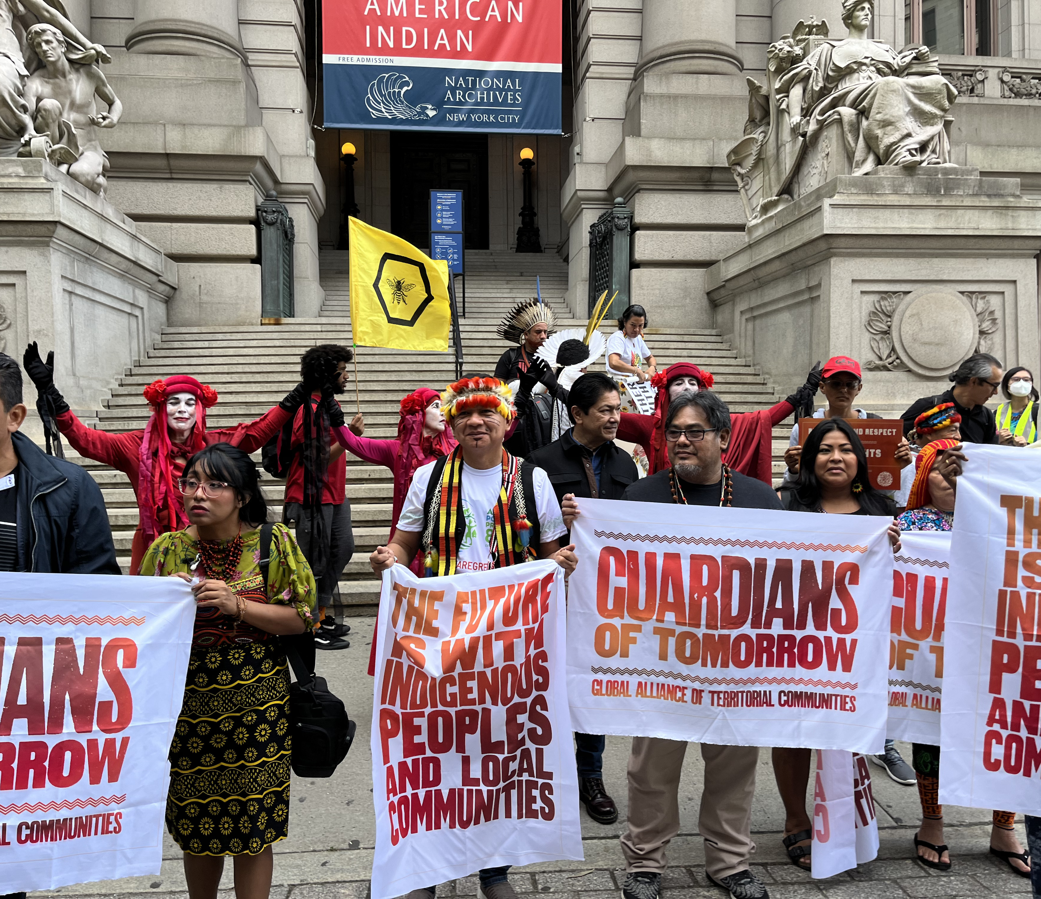
Post COP27: Reflecting on Donor Promises to Forest Guardians
December 1st, 1500-1630 CET

Slide 2
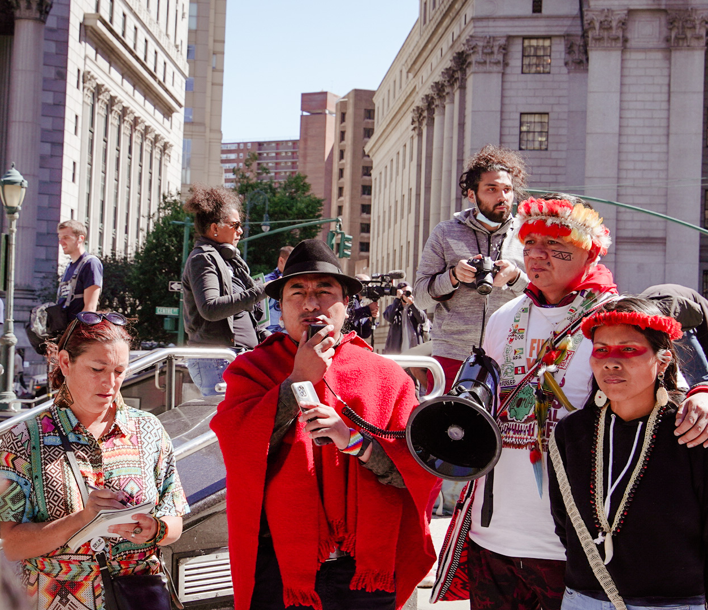
Post COP27: Reflecting on Donor Promises to Forest Guardians
December 1st, 1500-1630 CET

Slide 3
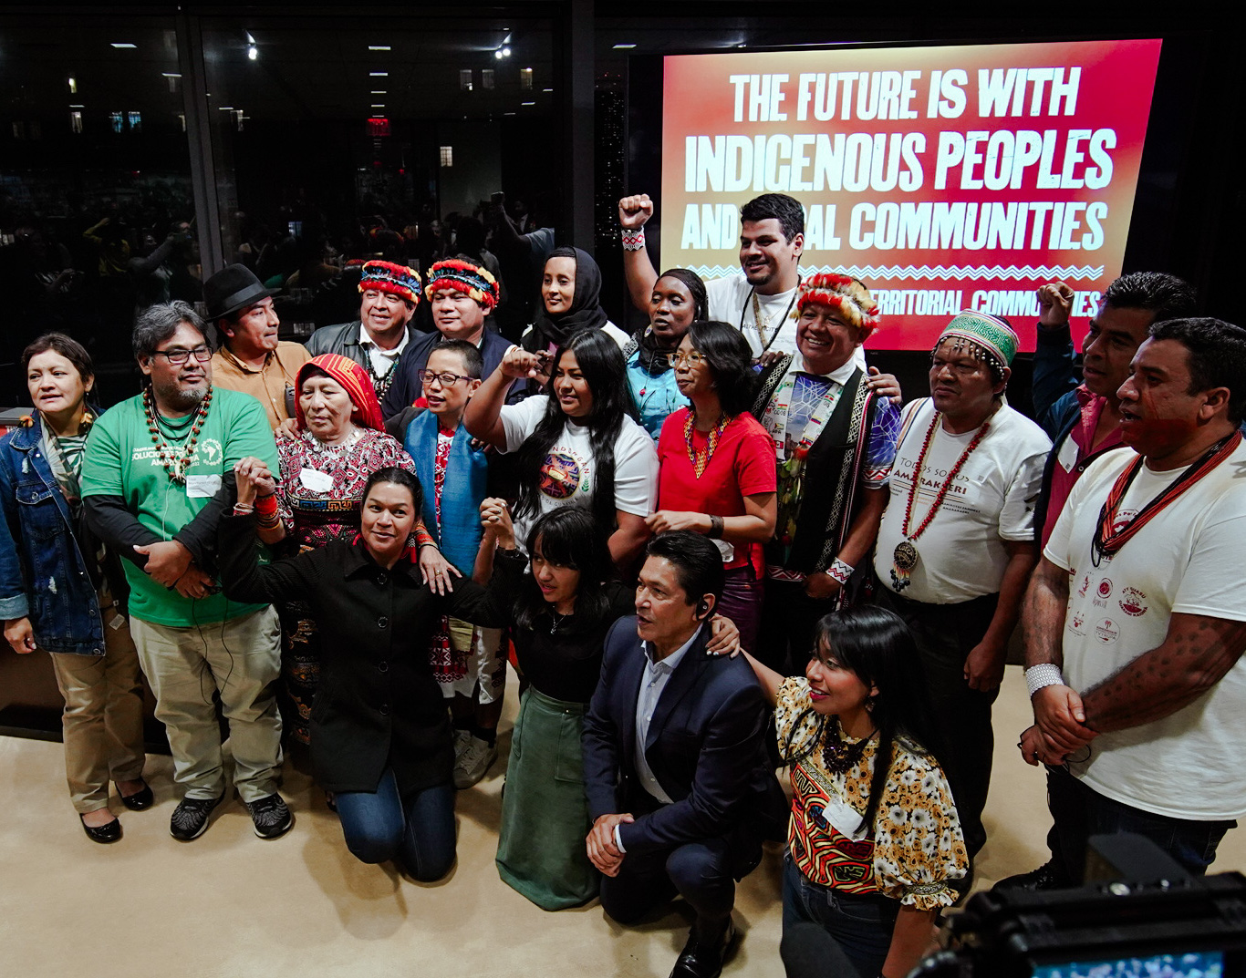
Post COP27: Reflecting on Donor Promises to Forest Guardians
December 1st, 1500-1630 CET

