Slide 1
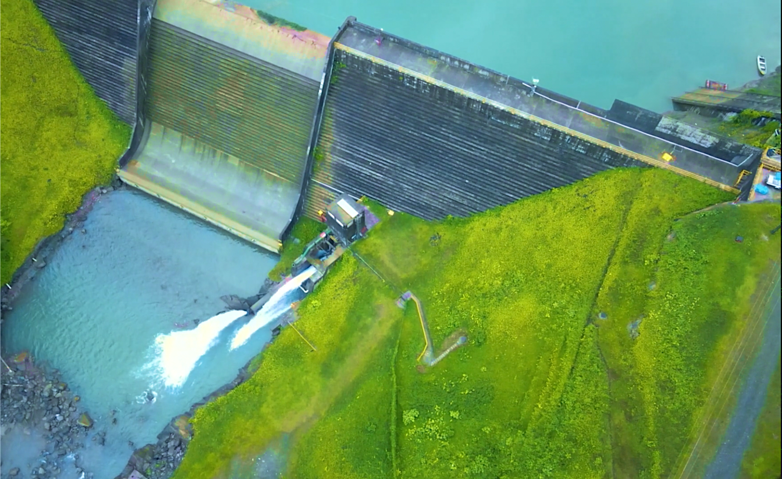



Energy Frontiers: Renewable energies in Indigenous territories
October 21st 15:00 – 16:30 CET

